Slide 1

Forecasting Hourly Power Consumption
Team :
Ms. Sakshi Bais
Mr. Rohit Patil
Ms. Tanvi Davare
Ms. Sakshi Wagh
Mr. Prashant Jadhav
Mr. Akshay Kamble
Mentors :
Mr. Rajshekar Sir
Pallavi Mam
Date : 21/03/2023

Slide 2
Business Problem:
PJM Hourly Energy Consumption Data :
PJM Interconnection LLC (PJM) is a regional transmission organization (RTO) in the United States. It is part of the Eastern Interconnection grid operating an electric transmission system serving all or parts of Delaware, Illinois, Indiana, Kentucky, Maryland, Michigan, New Jersey, North Carolina, Ohio, Pennsylvania, Tennessee, Virginia, West Virginia, and the District of Columbia.
Objective:
Split the last year into a test set- can you build a model to predict energy consumption?
Find trends in energy consumption around hours of the day, holidays, or long term trends?
Understand how daily trends change depending of the time of year. Summer trends are very different than winter trends.
Forecast for next 30 days.

Slide 3
Exploratory Data Analysis (EDA)

Slide 4
Data set details :
In our dataset there are 143207 observations and two columns namely Datetime and PJMW_MW.
The data is in datetime format. One day has 24 observations of at interval of 1 hours each.
The data starts from 2002-04-01 to 2018-08-03.
PJMW_MW column has energy consumption in Megawatts (MW).
 | Datetime | PJMW_MW
0 | 2002-04-01 01:00:00 | 4374
1 | 2002-04-01 02:00:00 | 4306
2 | 2002-04-01 03:00:00 | 4322
3 | 2002-04-01 04:00:00 | 4359
4 | 2002-04-01 05:00:00 | 4436
... | ... | ...
143201 | 2018-08-02 20:00:00 | 6545
143202 | 2018-08-02 21:00:00 | 6496
143203 | 2018-08-02 22:00:00 | 6325
143204 | 2018-08-02 23:00:00 | 5892
143205 | 2018-08-03 00:00:00 | 5489
The datatypes of Datetime column is datetime and PJMW_MW is integer.
In our dataset there are no null and duplicate values.
Mean = 5602.37,
SD= 979.14, Q1= 4907,
Q3= 6252, Median= 5530.
Mean and median are nearly same so we can say that our data is normally distributed.
143206 rows × 2 columns

Slide 5
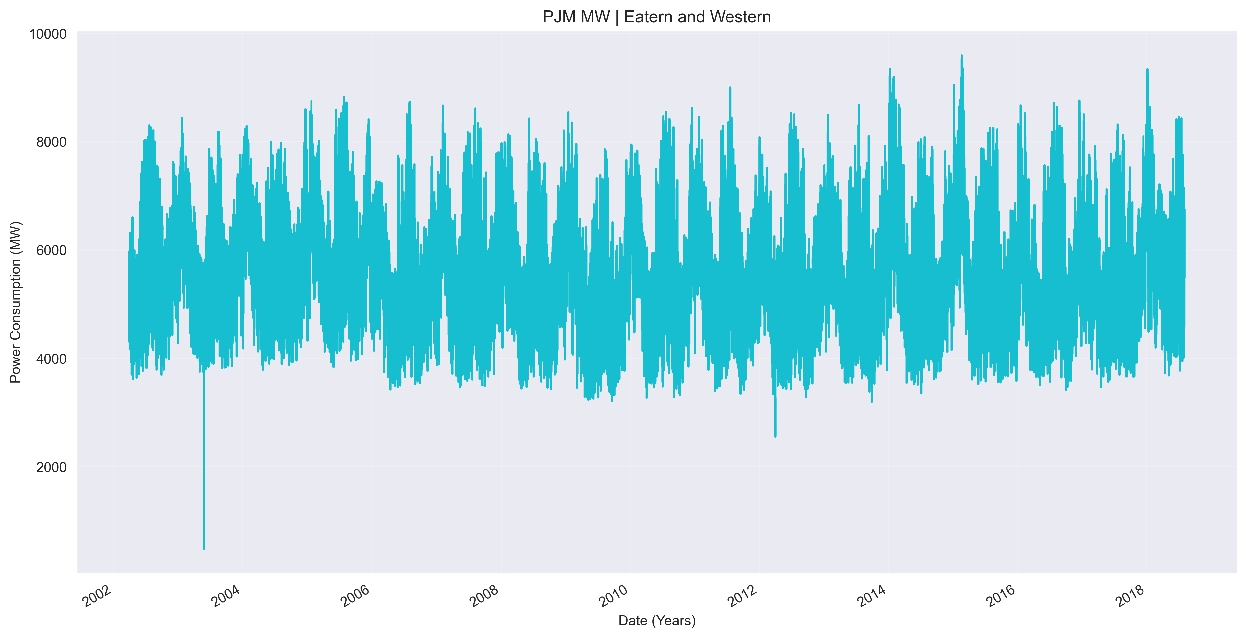
Data visualization :
As we can see, the time series plot shows irregular patterns with dense shading while plotting years wise, that means the energy consumed by peoples is having large variance/fluctuation over years.

Slide 6
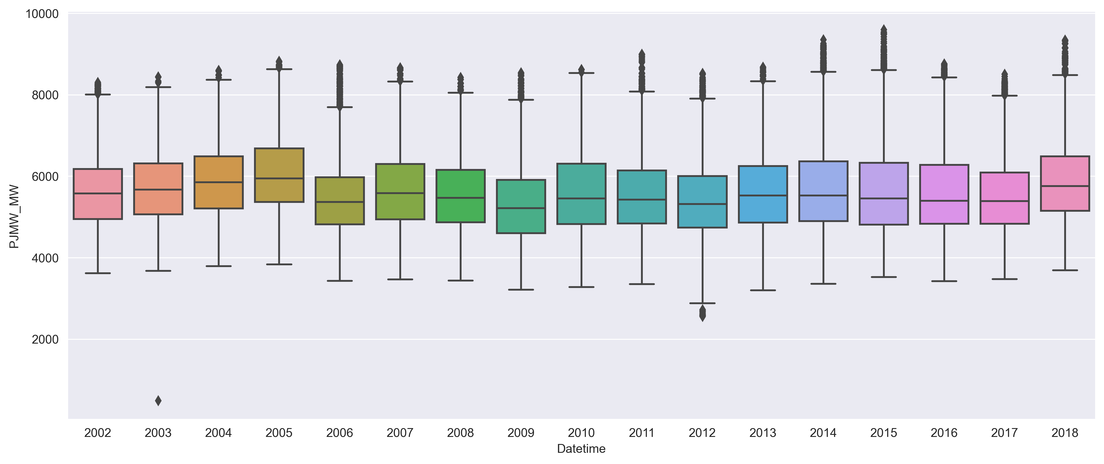
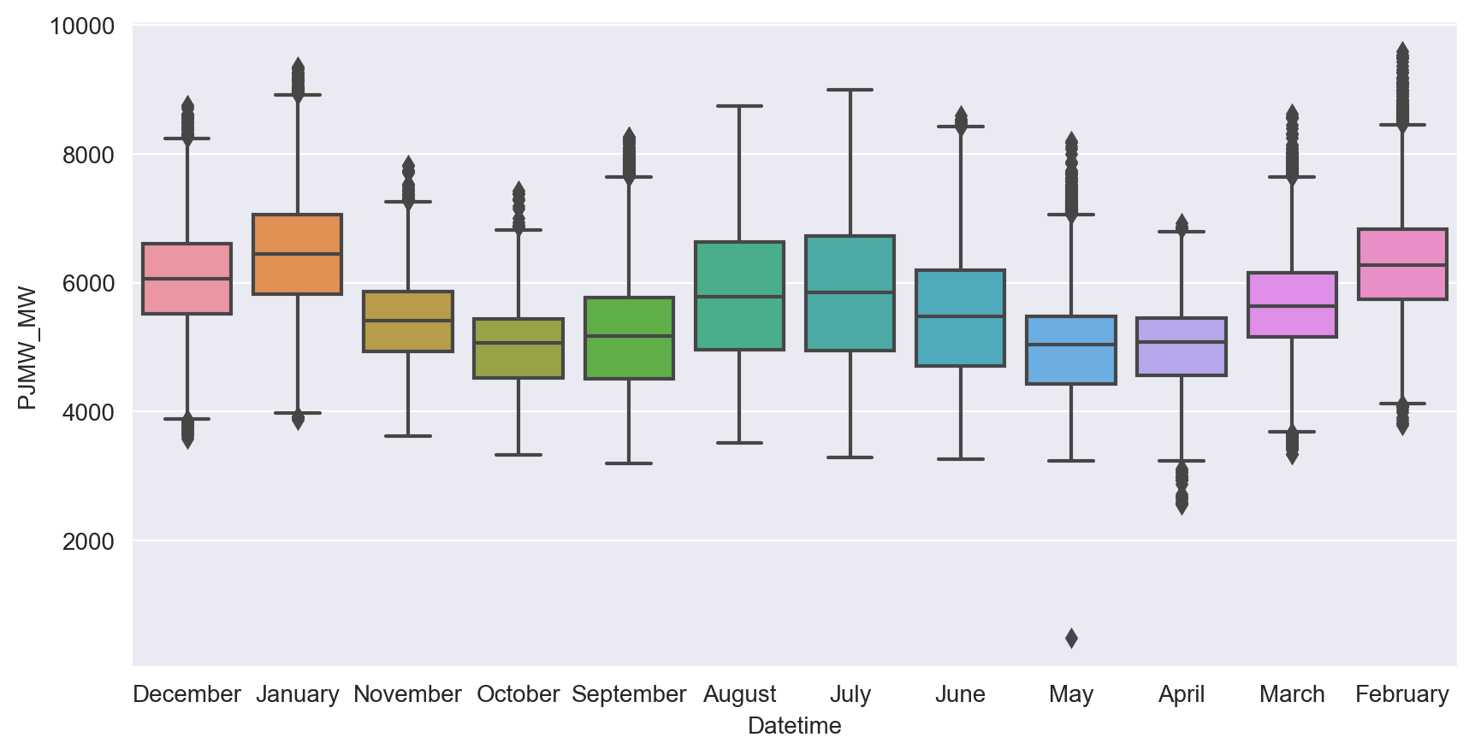
Boxplots :
As shown in above boxplots, we see that most of outliers are on upper extreme of boxplots with some stranglers at lower extreme. While lowest energy usage is in May 2003 and highest energy usage is in February 2015.

Slide 7
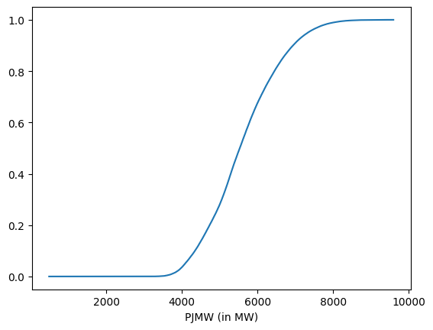
ECDF of energy usage :
While plotting Empirical cumulative distribution function of energy usage we can see that around 60% of power usage is less than 5600 MW while rest is greater than 5600 MW.

Slide 8
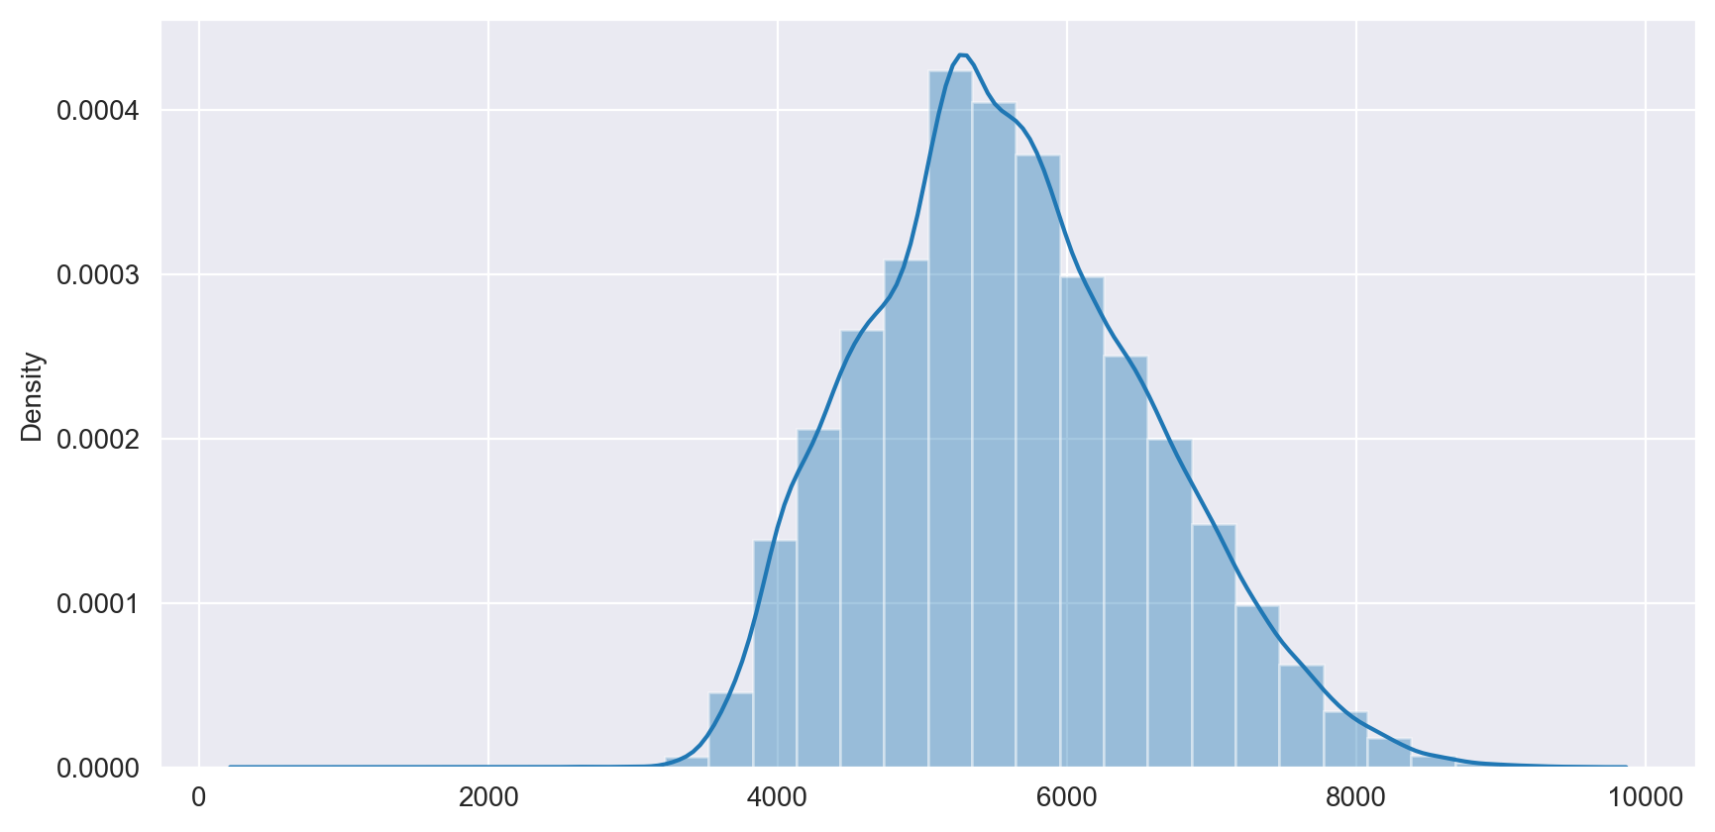
Histogram :
From this histogram, we say that our data is normally distributed.

Slide 9
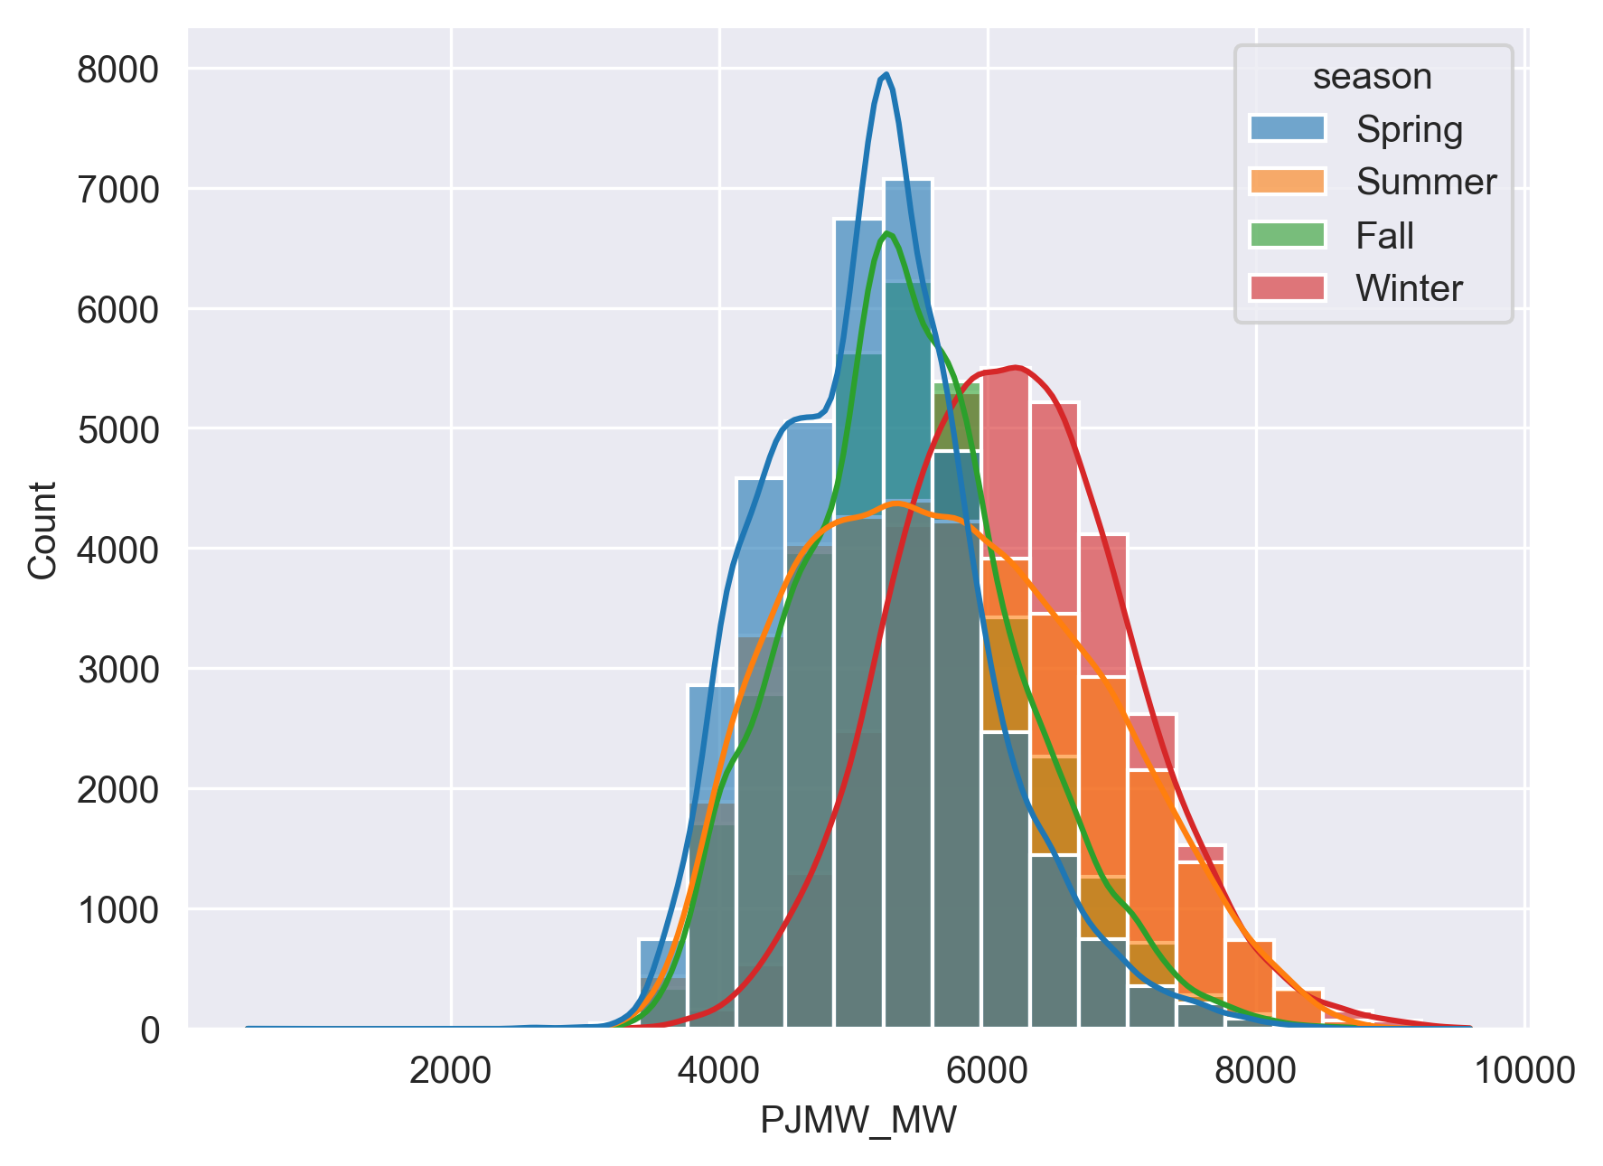
Season wise power usage :
From this histogram, we observe that, the peak of spring season is more than normal distribution i.e. the energy consumed by people in spring season is Leptokurtic.
The peak of summer season is less than normal distribution, i.e. the energy consumed by people in summer season is Platykurtic.
While energy consumed by people in fall and winter season follows normal distribution.

Slide 10
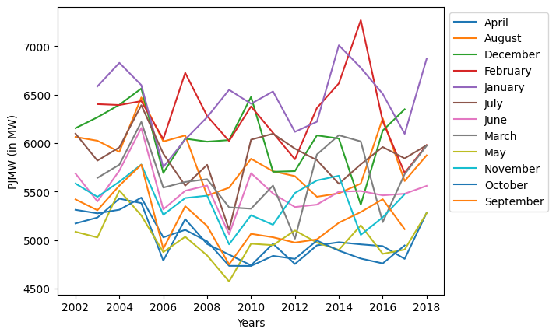
Monthly usage across years :
From this line chart, we say that there is no regular patterns of energy usage while plotting monthly usage across years , but we see that, in February month, there is higher variance in energy usage while in 2015 it is highest.

Slide 11
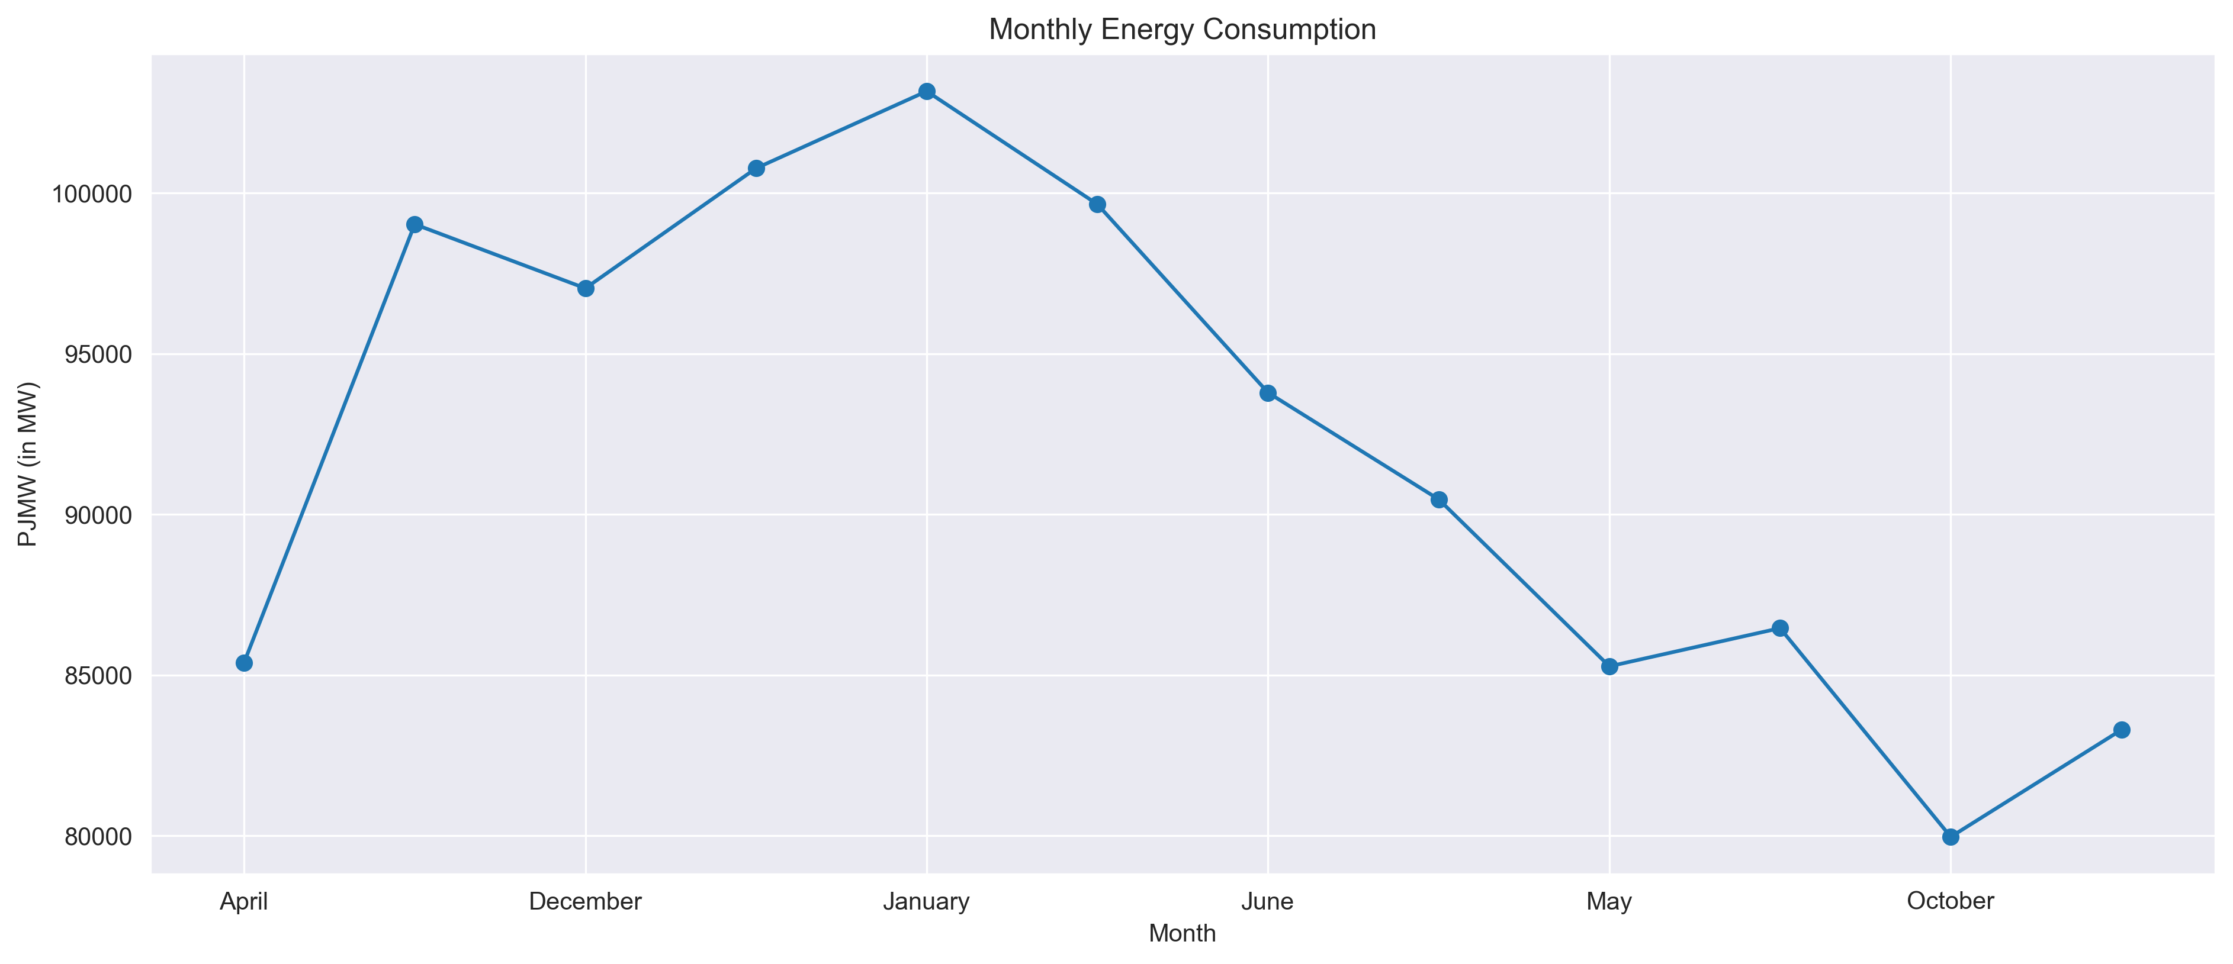
Monthly energy consumption :
when we plot total energy consumption by months, in April to October the line goes up drastically, and in December it goes down slightly, from this we can say that, the energy consumed in April to October is increased significantly.
From December to January there is again drastic change in energy consumption line. In January month energy consumption is highest as compared to other months.
After January energy usage shows downwards trend indicating less use of electricity.

Slide 12
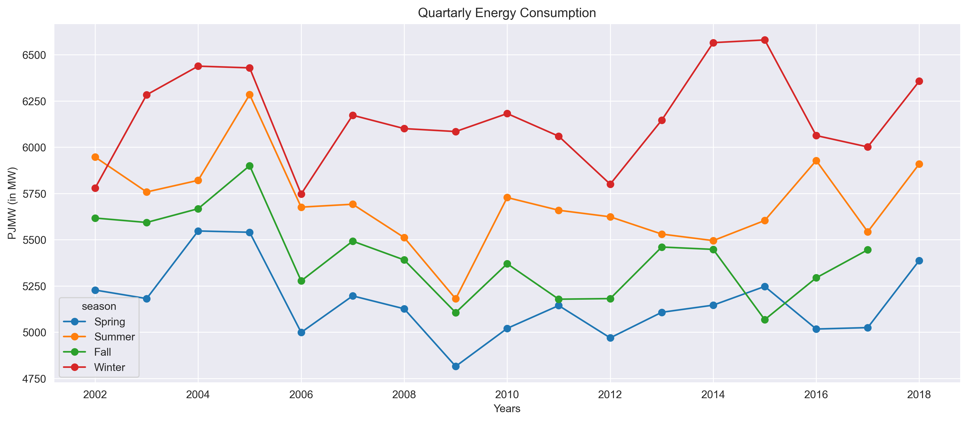
Energy Consumption by Seasons:
When we plot total energy consumption by season, we see that, the energy used by peoples in winter and summer season is higher than in spring and fall seasons.
In the winter of 2015 has highest energy consumption and spring season has lowest energy consumption.

Slide 13
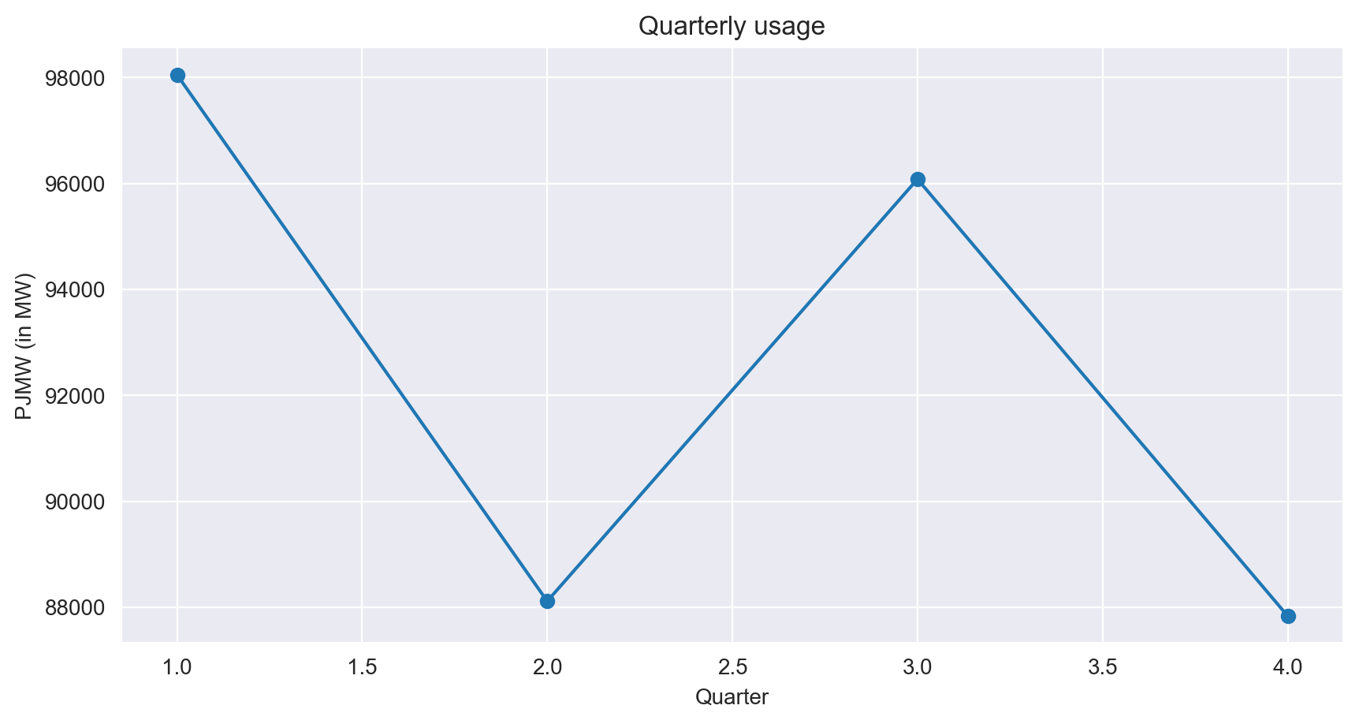
Quarterly energy consumption:
When we plot total energy consumed by people from 2002-2018, we see that, people used more electricity in 1st and 3rd quarters of year.
While electricity used in 2nd and 4th is very less as compared to 1st and 3rd quarters.

Slide 14
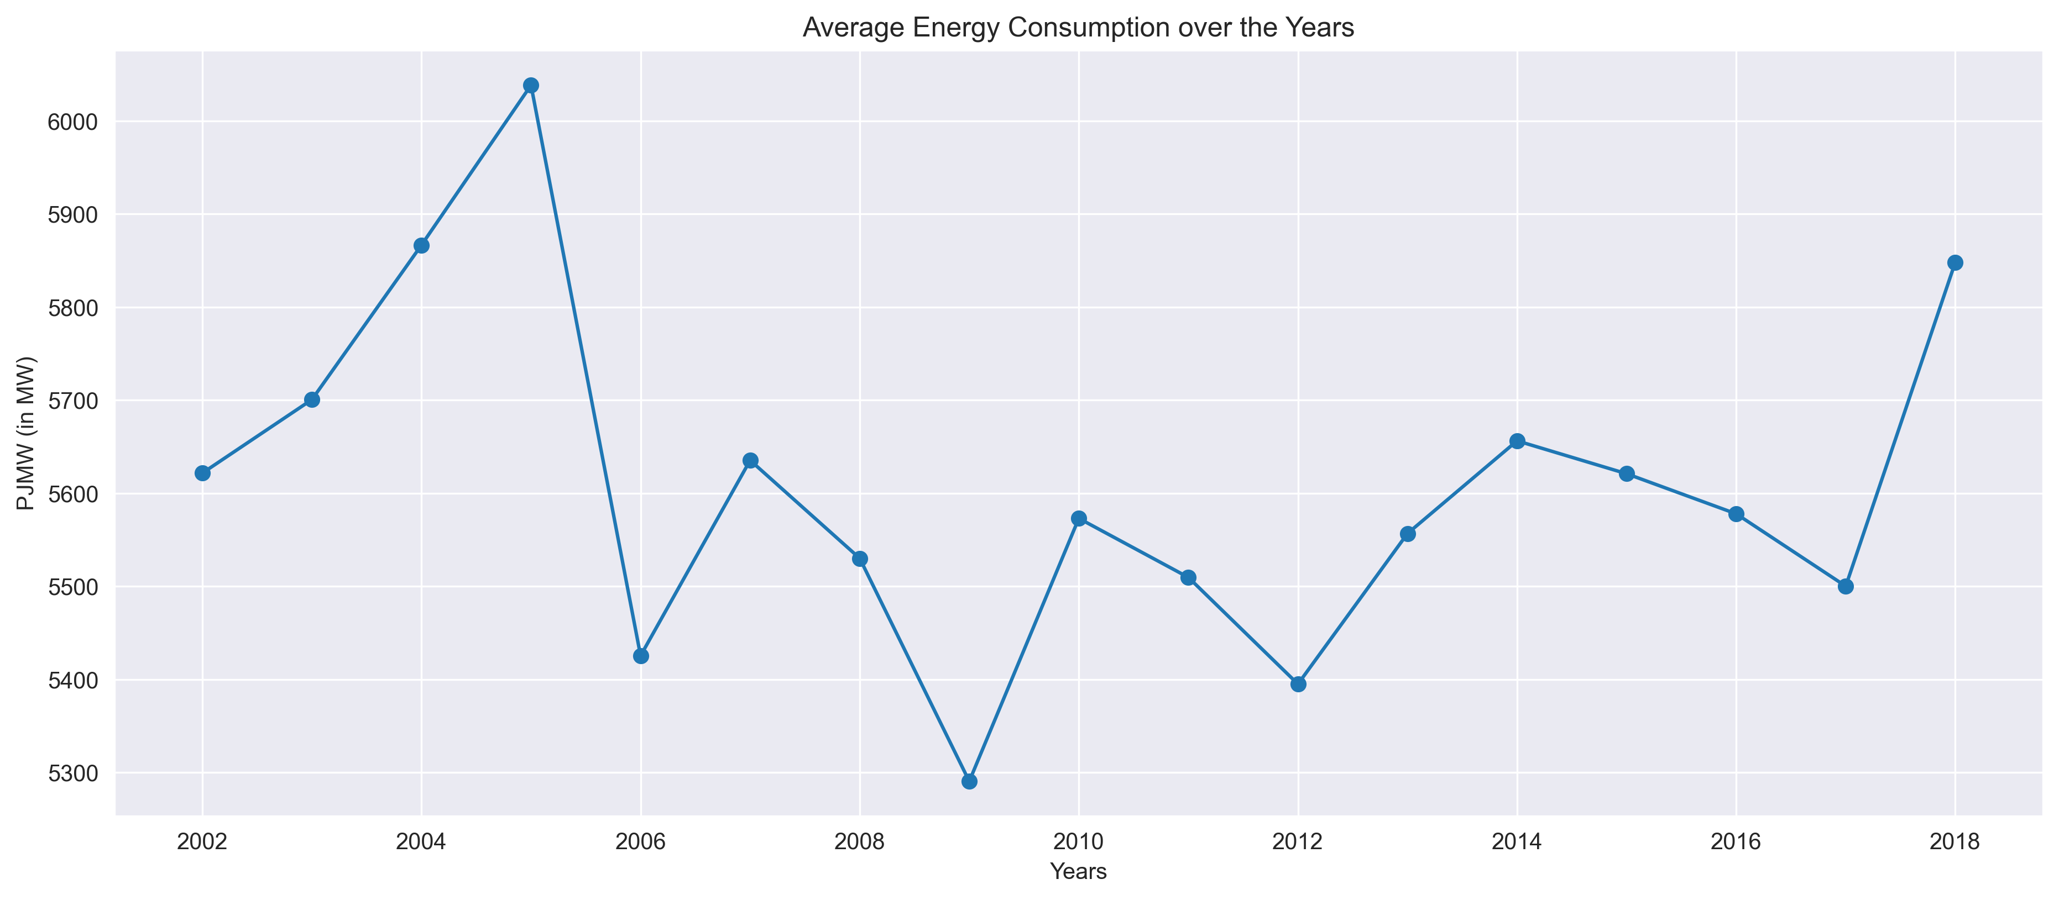
Average energy consumption over years:
When we plot average energy consumption over year, we see that 2005 has highest energy consumption followed by 2018.
In 2009 we have lowest energy consumption followed by 2012.
From 2006 to 2016 energy consumption doesn’t show drastic changes.
From 2017 the power consumption seems to be increasing.

Slide 15
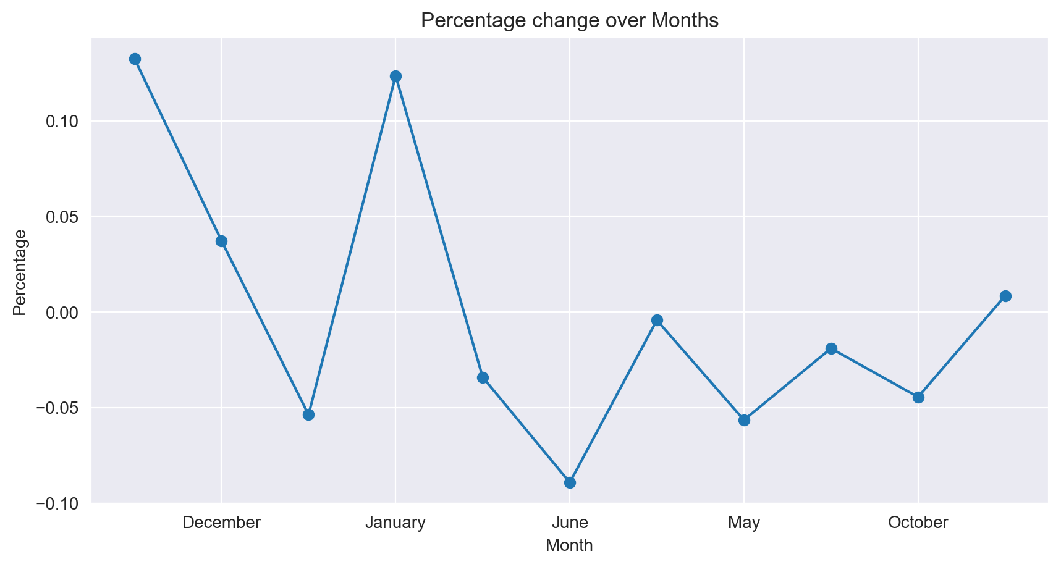
Percentage change over months :
When we plot percentage change energy consumption over the months, then we see that, for month of August percentage change is highest while it is lowest for month of June.

Slide 16
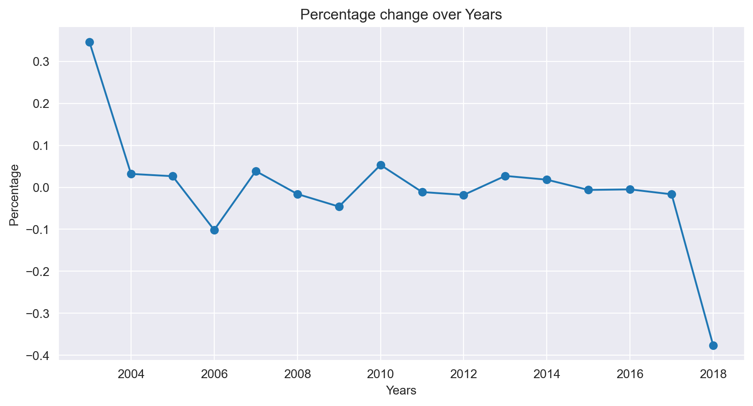
Percentage change over years :
Percentage change over years :
While plotting percentage change energy consumption over the years we see that, for 2003 percentage change is highest while it is lowest in 2018.
For rest of the years the percentage change is between 0.1 to -0.1 range.

Slide 17
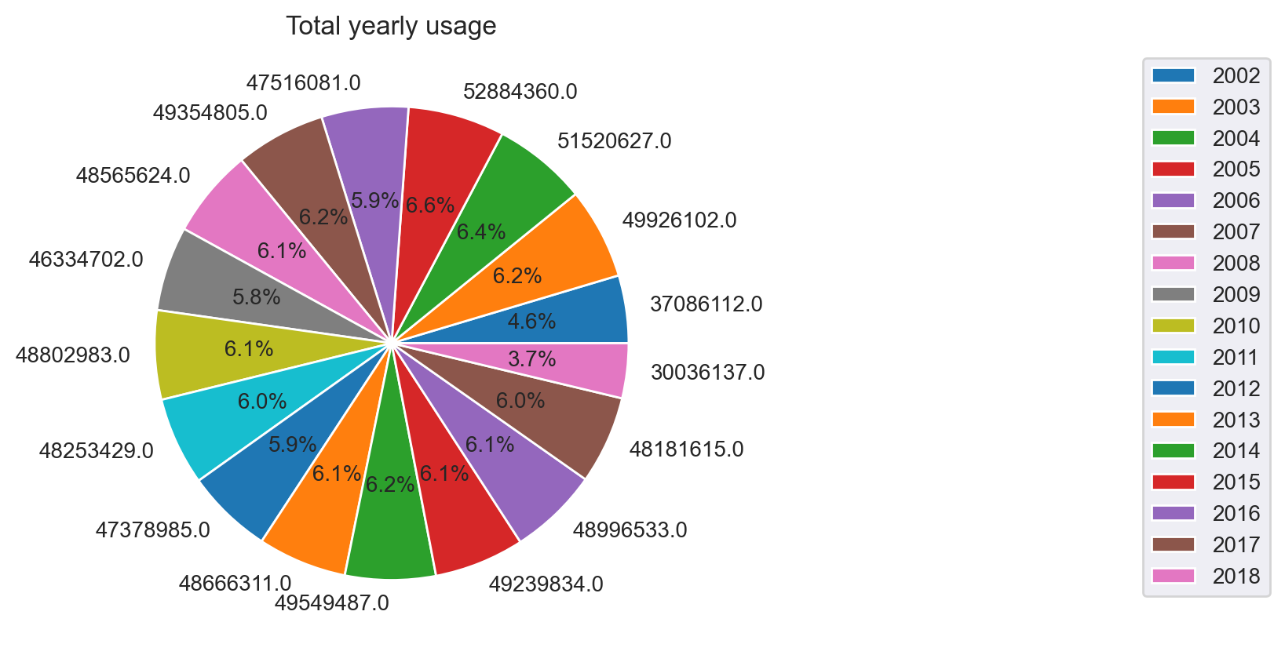
Pie charts :
From above pie chart we can see that, 2005 has highest energy usage of 52884360.0 MW while 2018 has lowest energy usage of 30036137.0 MW.

Slide 18
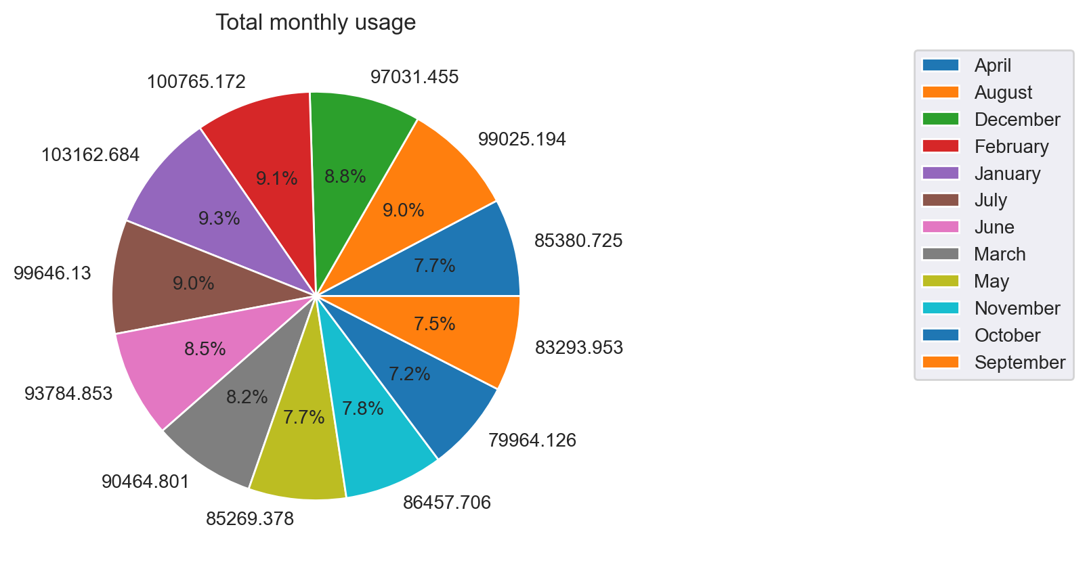
From above pie chart we can see that, month of February has highest energy usage of 100765.172 MW while month of October has lowest energy usage of 79964.126 MW.

Slide 19
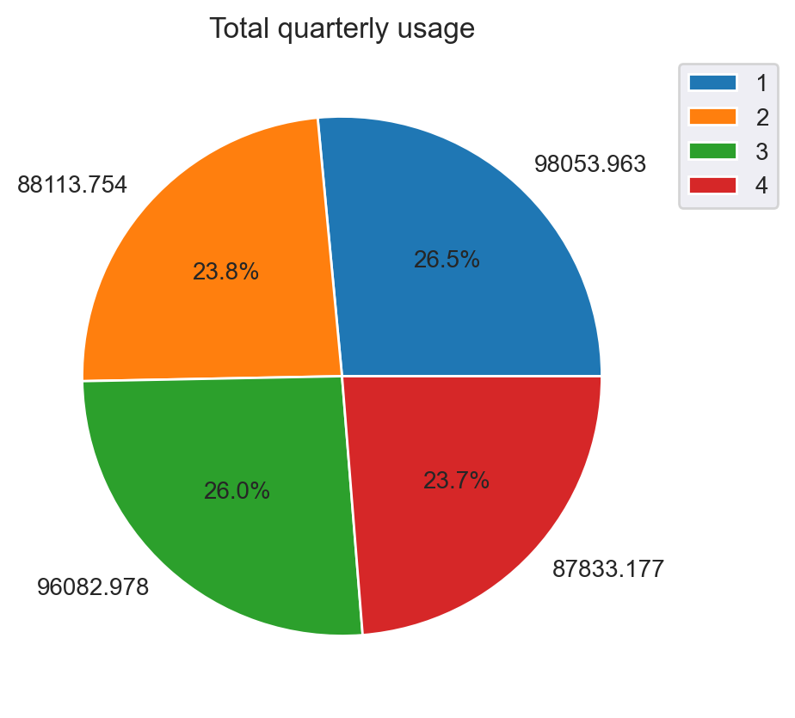
From above pie chart we can see that, 1st quarter has highest energy usage of 98053.963 MW while 4th quarter has lowest energy usage of 87833.177 MW.

Slide 20
Thank you

